Slide 1

Insurance Premium and Payout KPI Dashboard
Trusecure CreDebit Insurance – Innovating Financial Protection for a Secure Tomorrow
Presented By: Sravani G

Slide 2
Contents
1. Problem Statement
2.Tools used
3.Key Metrics
4.Premium Breakdown
5.Geographic & demographic Performance
6.Sales Agent Performance
7.Investment Performance and ROI Trends
8.Future Cash Flow and ROI forecast
9.Insights

Slide 3
1.Problem Statement
TruSecure CreDebit Insurance manages a complex portfolio of policies from 2015 to 2025, yet critical data on policy creation, tenure, customer details, claims, loan information, and maturity calculations remains fragmented across multiple systems. Without a unified view, stakeholders struggle to track overall business performance, analyze claim trends, or accurately forecast maturity amounts, leading to delayed and reactive decision making. The organization lacks real-time visibility into how different policy types perform across customer segments and states, making it difficult to identify top-performing plans or flag products with low uptake for timely intervention. Additionally, claim settlement performance and process inefficiencies are not actively monitored, which impacts customer satisfaction and increases operational costs. Sales, claims, and loan servicing teams operate without shared, transparent KPIs, resulting in inconsistent accountability and performance gaps across business units. Because reporting is manual, data quickly becomes outdated and stakeholders cannot access the latest insights needed for premium collection, payout planning, and risk management. To address these challenges, TruSecure requires an automated, interactive Power BI dashboard that consolidates the complete policy lifecycle into a single source of truth, enabling real-time analysis by policy type, state, and segment while driving accountability and faster strategic decisions

Slide 4
2.Tools Used
Power Bi(DAX)
MS Excel

Slide 5
3.Key Metrics
Metric | Value
No. of policies | 7,299
Total Annual Premium | 2,161.60M
Total Premium Amount | 39,096.58M
Total Premium paid | 10,686.35M
Total Premium Payable | 28,410.24M
Underwriting Expenses | 38.66M
63.82% of premium has been paid, with 36.18% payable in 5 Years.

Slide 6
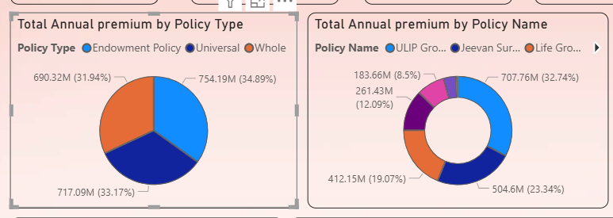
4.Premium Breakdown By Product
What Products Drive Our Premium ?
ULIP Growth Plan and Jeevan Suraksha are flagship products, driving 56% of annual premium

Slide 7
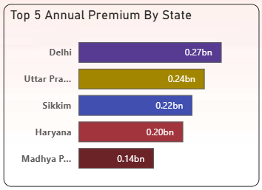
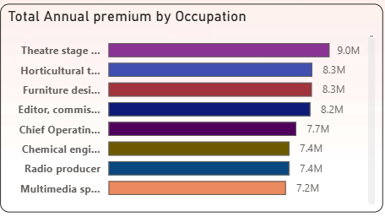
5.Geographic & Demographic Performance
Where & Who Is Buying ?
Theater Stage Manager, Horticultural therapist, Furniture Designers are the top occupations.
North India Dominates revenue.

Slide 8
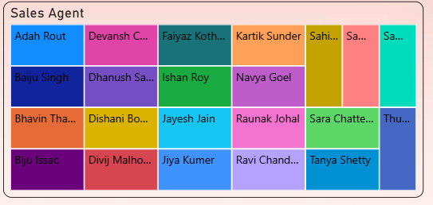
6.Sales Agent Performance
Agent Productivity & Pipeline
Insights:
Sales Trend: Annual Premium from agents grew from 0.09bn in 2016 to 0.32 in 2024.
Top Performers: Baiju Singh, Divij Malhotra, Ananya Sharma are the top performers.
Pipeline Gap: Total Premium Payable Consistency higher than paid across agents

Slide 9
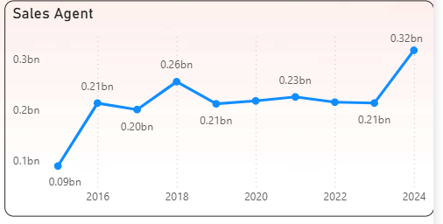
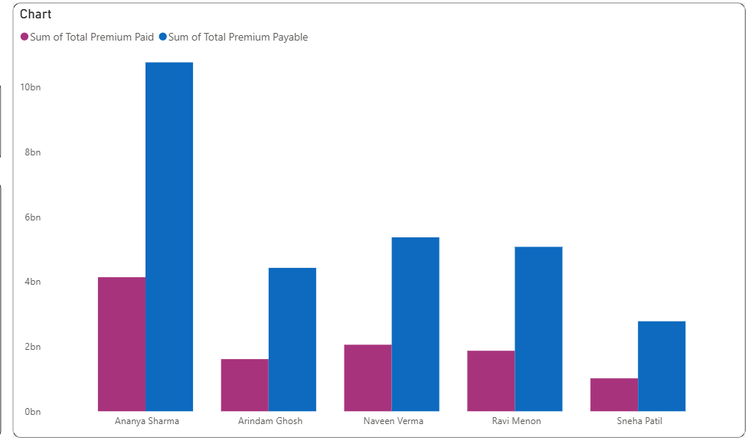
7.Sales Agent Performance

Slide 10
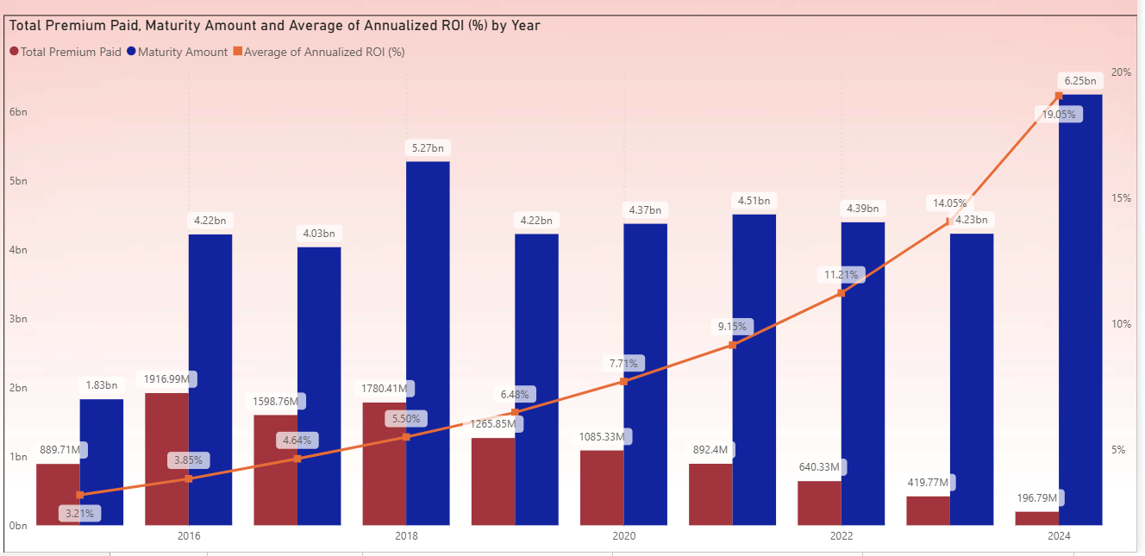
8.Investment Performance & ROI trends
Maturity Value & ROI Are Accelerating
Key Trends 2015-2024
Maturity Amount: Grew from 1.83bn to 6.25bn
Total premium Paid: Declined from 1916.99M to 196.79M
Avg Annualized ROI: Jumped from 3.21% to 19.05%

Slide 11
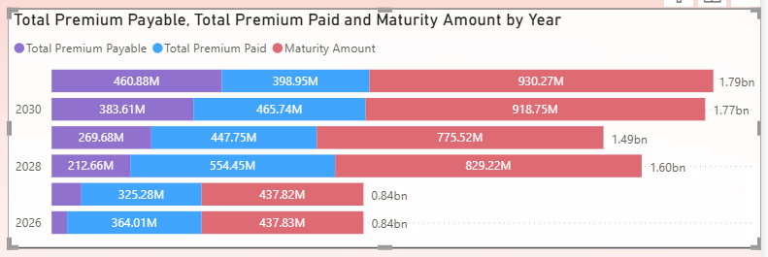
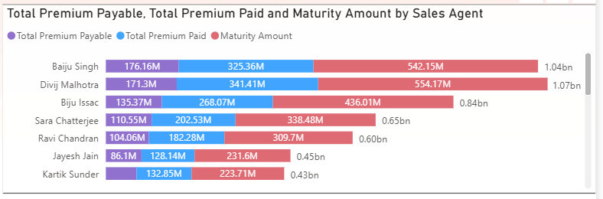
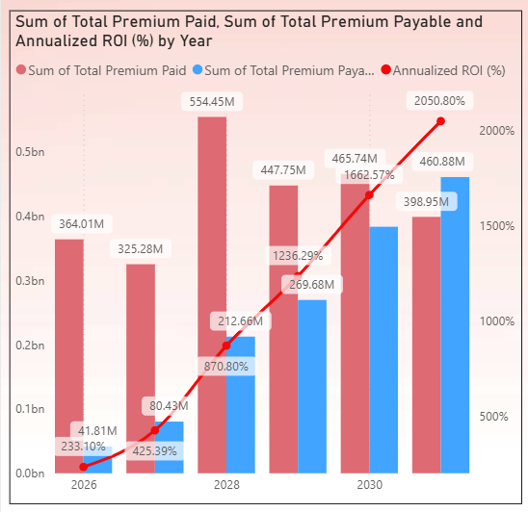
9.Future Cash Flow & ROI Forecast
2026-2030 outlook: Strong ROI Pipeline
Maturity Amount 2026: 0.84bn → 2030:1.79bn
Annualized ROI 2026: 233.10% → 2030:2050.80%
Top Agent Pipeline: Baiju singh has 542.15M maturity amount pending

Slide 12
10.Insights
The business manages 7,299 policies worth ₹39B in total premium, with ₹28.4B still payable over the coming years.
Universal, Endowment, and Whole Life policy types each contribute roughly one-third of annual premium, showing a well-balanced product mix.
Life Growth and Jeevan Suraksha together drive over 55% of annual premium, indicating heavy revenue dependence on two flagship plans.
Delhi, Uttar Pradesh, and Haryana are the top-performing states, while Sikkim shows unusually high premium for its size.
Agent-driven premium has grown steadily from 2016 to 2024, with a few top agents managing most of the maturity pipeline.
Creative occupations like theatre artists, horticulturalists, and furniture designers show higher premium adoption than traditional corporate roles.
ROI increases significantly with policy tenure, with matured policies showing 19%+ annualized returns compared to 3% in early years.
Underwriting expenses remain very low at under 2% of annual premium, indicating strong cost control across operations.

Slide 13
Thank You
Thanks For Checking Out This Project
Reach Out For Discussion: sravani.ginamoni@gmail.com

